Slide 1
Deploy using GitHub Desktop

Slide 2
Preface
My workflow is a bit different than what will be demonstrated in this lecture. I do not use GitHub desktop professionally. However, that doesn’t mean it is not an acceptable tool to use in professional or personal environment. Tools are meant to get a job done and at the end of the day that’s all that matters is the job gets done.
Because of this you may find differing material and resources online. All that is completely acceptable to follow if it works for you or others.
Good YouTube Series:
Getting Started With GitHub Part 1
Getting Started With GitHub Part 2
Getting Started With GitHub Part 3

Slide 3
What is GitHub Desktop?
GitHub Desktop is a Graphical User Interface for interacting with GitHub
Available on MacOS and Windows
Designed by the folks at GitHub
Free

Slide 4
Installing GitHub Desktop
Download GitHub Desktop
Install GitHub Desktop (locate GitHubDesktop.zip on your file system)
Once installed you will be prompted to enter your GitHub.com credentials
Step through the rest of the steps, you may receive an e-mail a 3rd party app has authorized your account

Slide 5
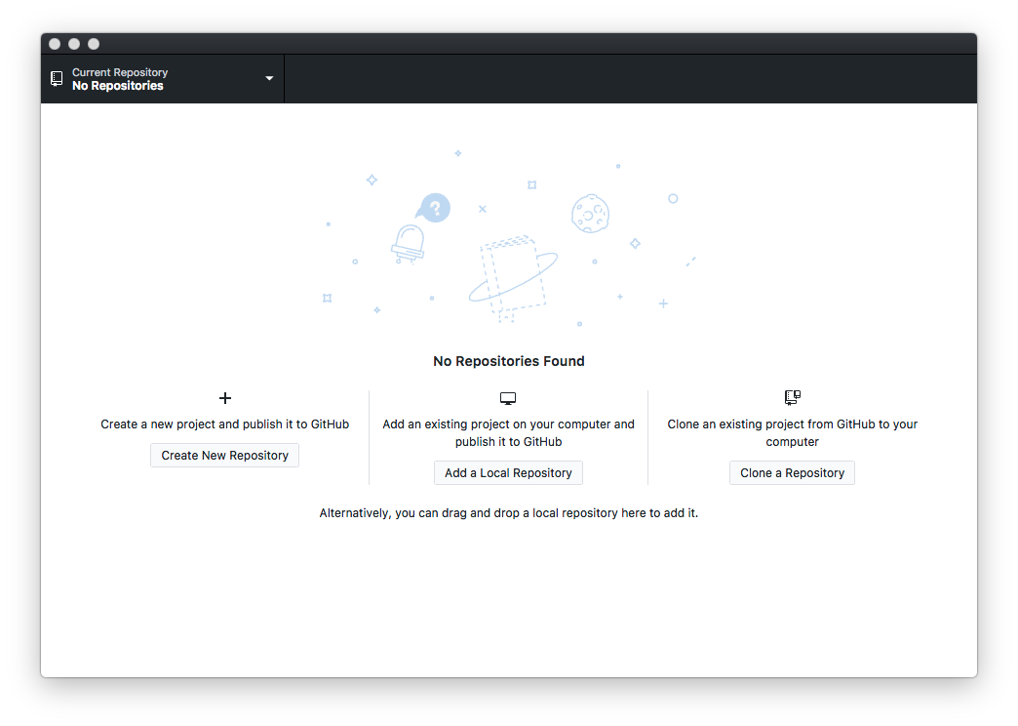
Setting up your first Repo
Create a new project and publish?
You don’t have Git files in your project
Add an existing project and publish?
You have Git files in your project
Clone an existing project from GitHub?
There’s code already on GitHub you want to download and work on

Slide 6
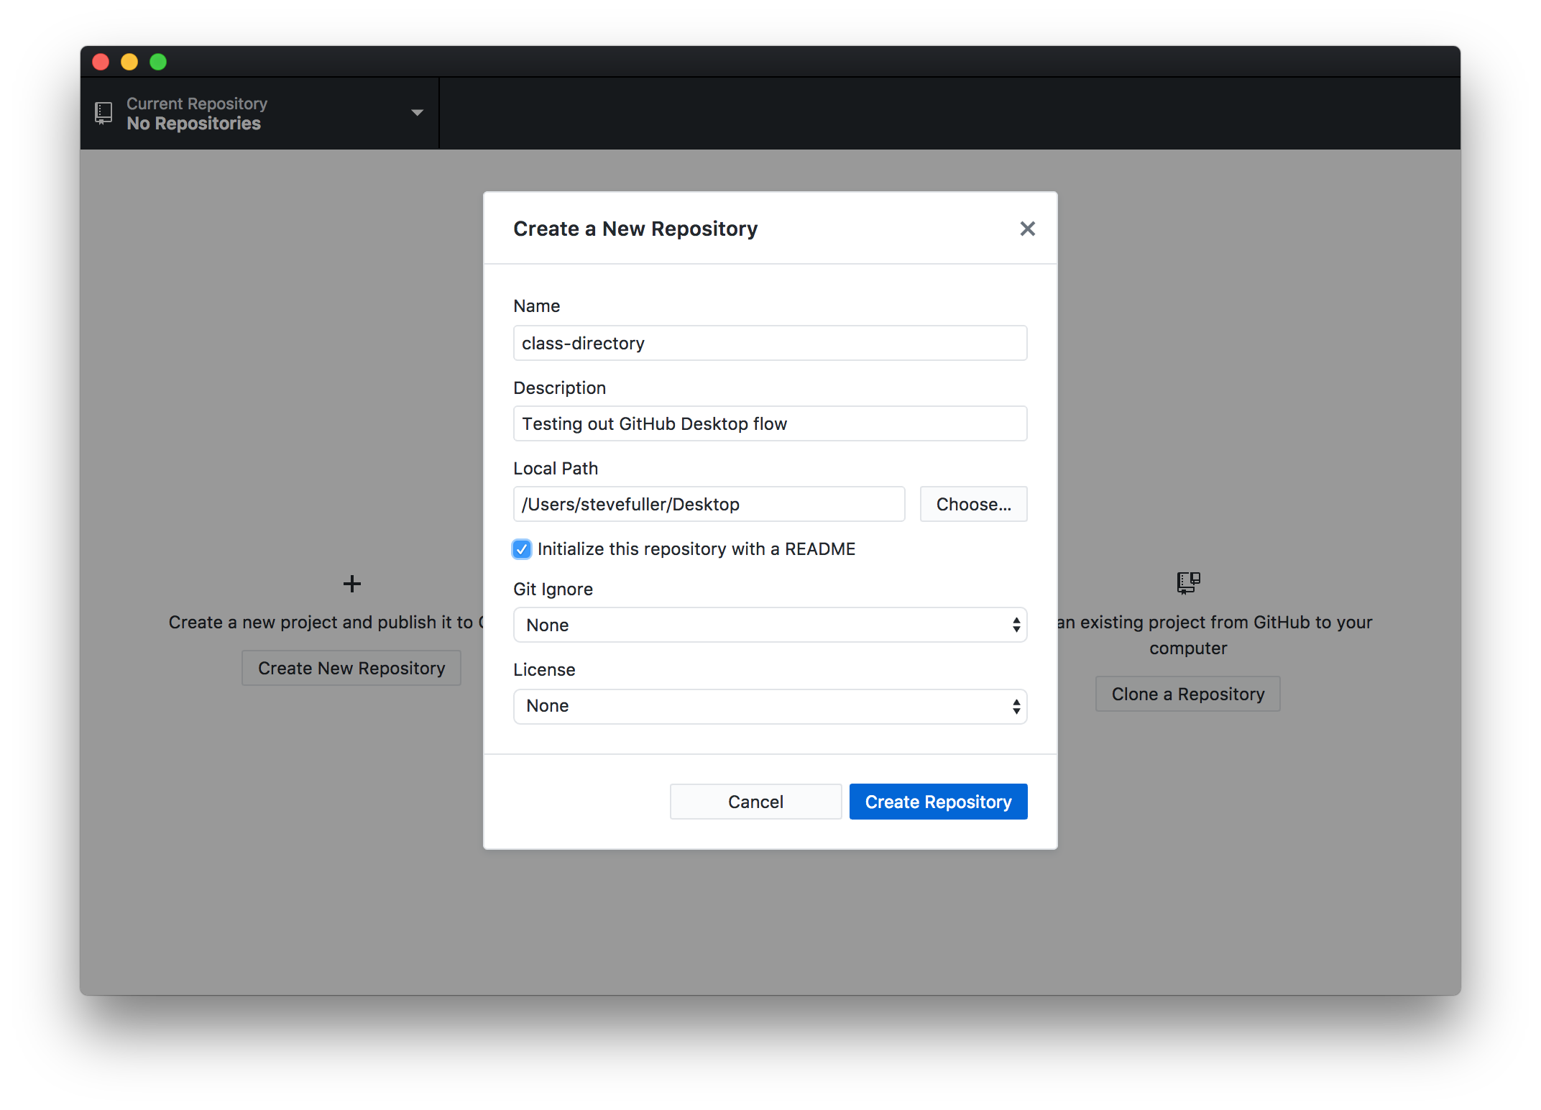
Create a new project
Name your project
Write Description
Where do you want your Repo to reside on your filesystem?
Initialize with README?
A README is information about your project like installation instruction(s), how to use, FAQs, etc.
Git Ignore
Files you don’t want in GitHub
License
Copyright protections
Creating this will create a new folder with your essential Git files

Slide 7
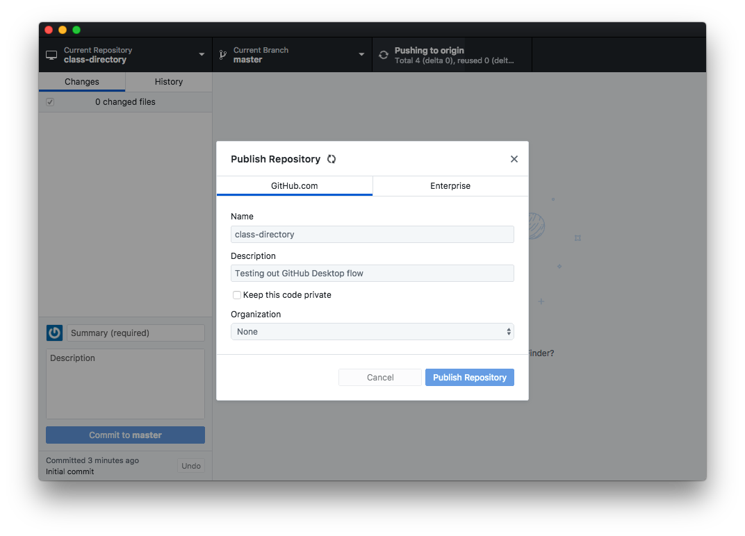
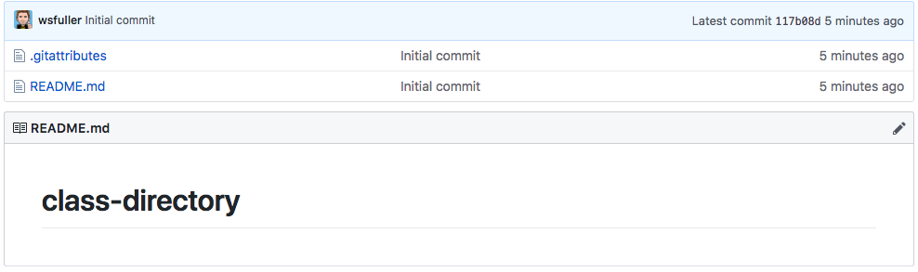
Publish Repository
In the top right corner press “Publish Repository”
Now go to: github.com/:username/:repo-name
And you should see something like:

Slide 8
Congratulations you’ve just published to GitHub!!!

Slide 9
But like, where’s my code and stuff?!?!

Slide 10
One more thing… the .gitignore file
.gitignore is a file we use to omit certain files from being submitted to GitHub
macOS gitignore
Windows gitignore
Here are a couple basic files that should cover our needs. For example though you don’t want to be committing things like .psd, .sketch, etc files into GitHub. The .gitignore should always be updated before for code commits to avoid any unnecessary files from accidentally being committed.

Slide 11
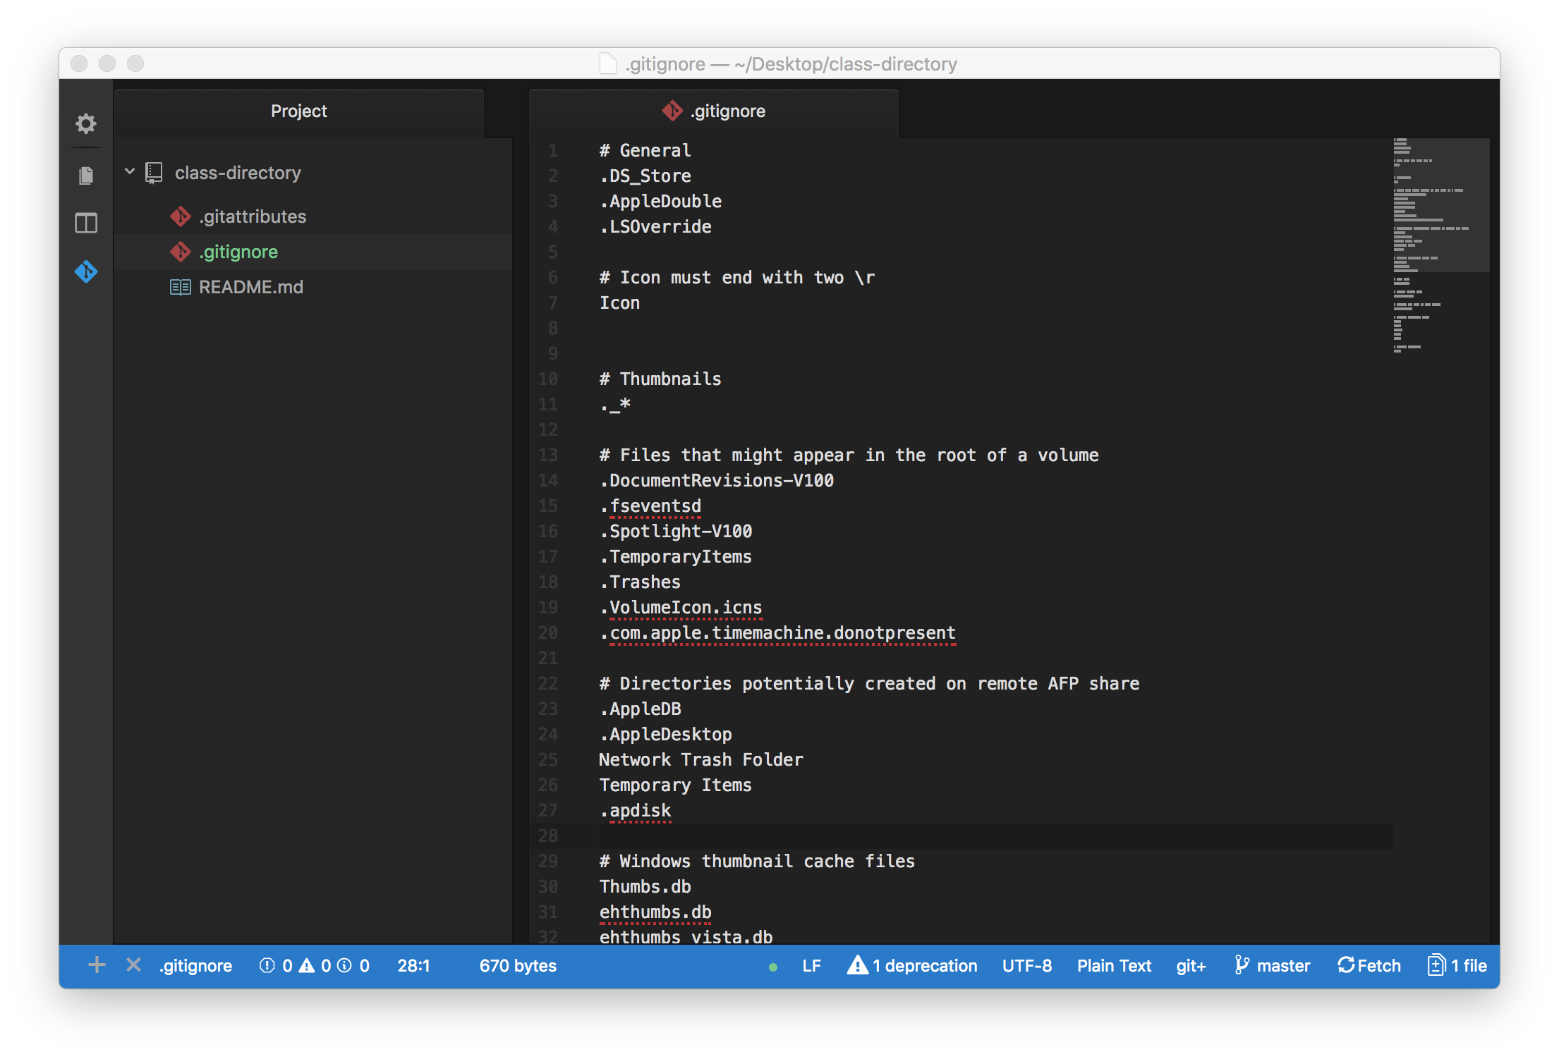
Adding your .gitignore
Open up your GitHub folder that was created in Atom
Make a new file called “.gitignore”
Paste in the sample code from the previous slide links
Commit this new file to your GitHub repo

Slide 12
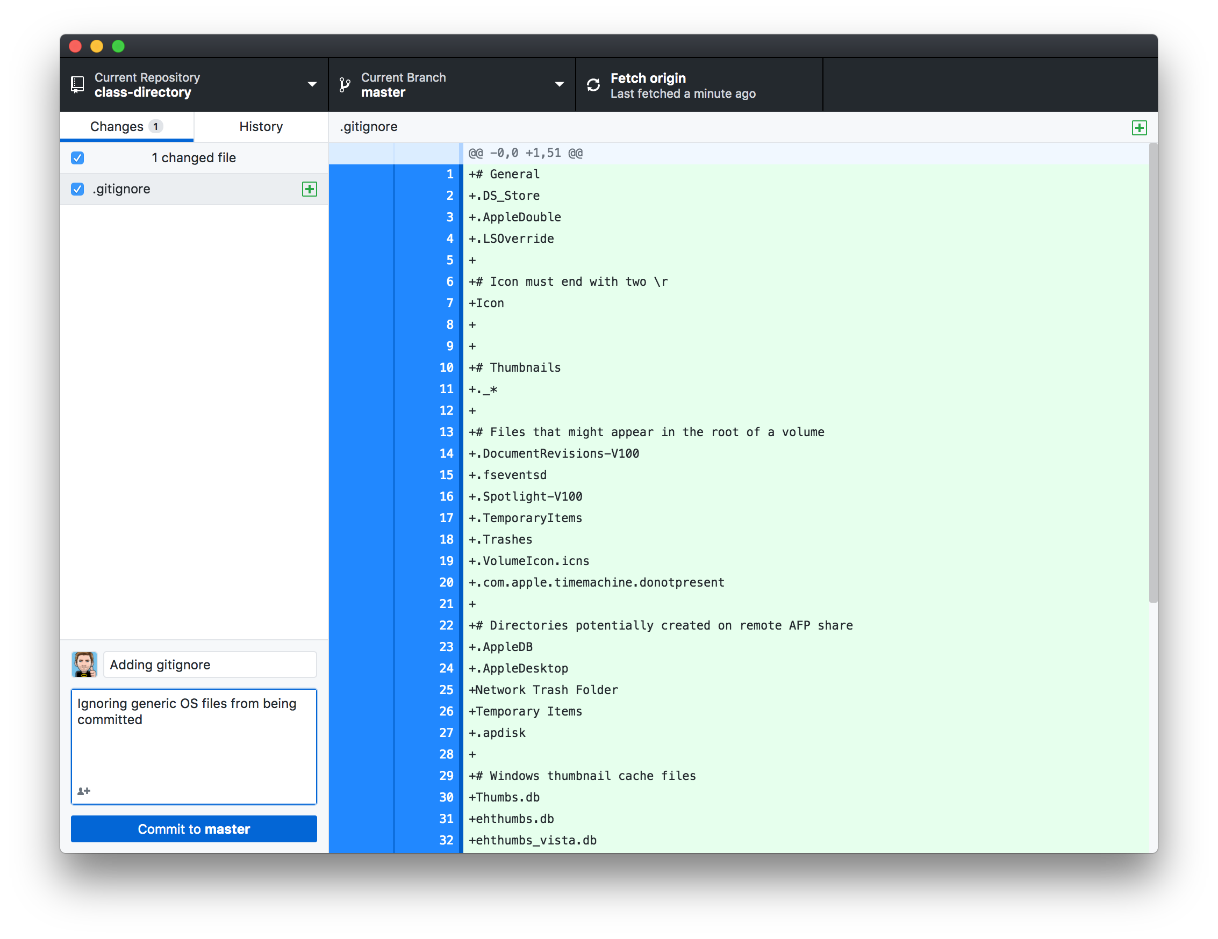
Commit your .gitignore
Open GitHub desktop
Fill out Summary
Fill out Desktoption (optional)
Commit to master
Click Push origin
Visit your repo

Slide 13
You’ve just updated your repo!!!

Slide 14
But like, where’s my code and stuff?!?!

Slide 15
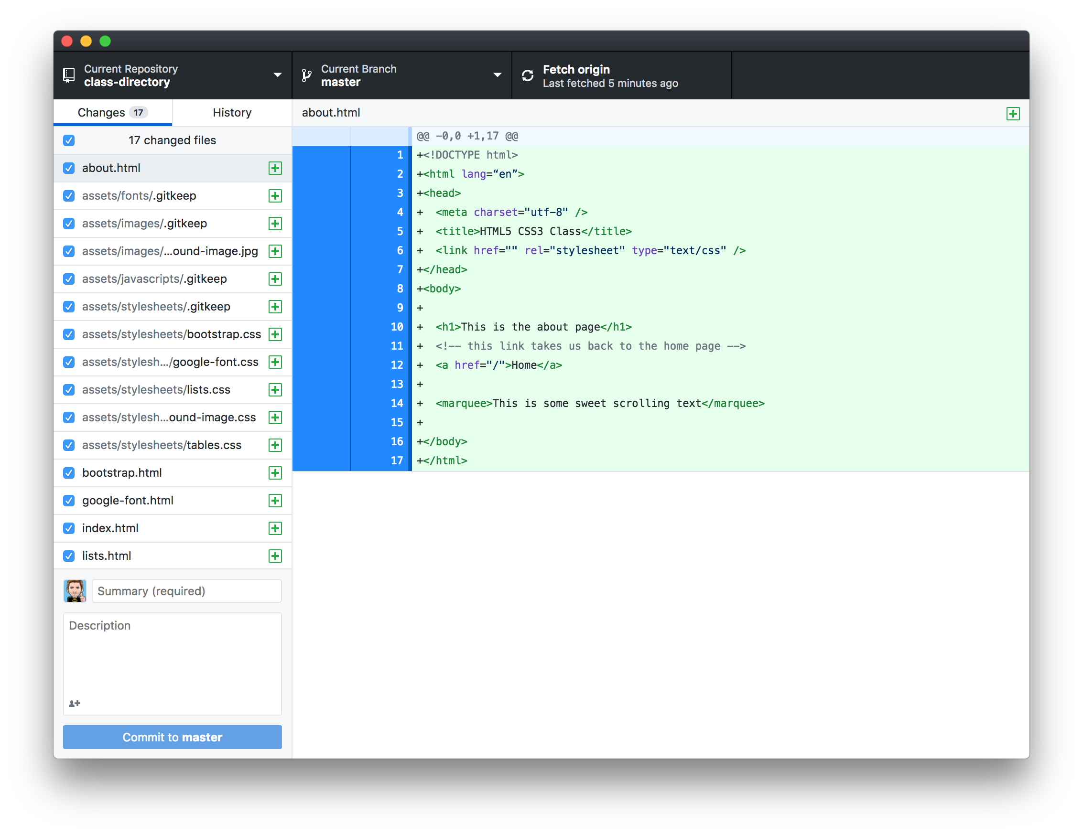
Let’s get our actual code up
All we’ve done is prepare a folder that’s linked to GitHub, there’s a couple more steps to get this all working
Copy your working code into the one you just created for GitHub
Now you should see your files showing up
Summary
Description
Commit to master
Push to origin
Visit your GitHub Repo
Pat self on back

Slide 16
Oh yeah

Slide 17
But we aren’t quite done yet...

Slide 18
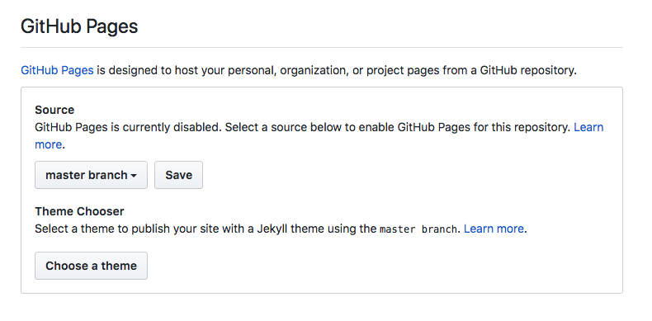
Publish to GitHub Pages
GitHub pages will allow GitHub to take our code and publish a working website for everyone to view
Go to your GitHub Repo page
Click the Settings tab
Scroll down till you see “GitHub Pages”
Source should be your master branch
Click save
You should see a link: “Your site is ready to be published at :URL
Go grab a coffee and should be live in ~30 minutes

Slide 19
Congrats on using GitHub and Deploying your site!!!

